Slide 1
Creation of NASA
From Wikipedia, the free encyclopedia
https://en.wikipedia.org/wiki/Creation%20of%20NASA
Licensed under CC BY-SA 3.0:
https://en.wikipedia.org/wiki/Wikipedia:Text_of_Creative_Commons_Attribution-ShareAlike_3.0_Unported_License

Slide 2
Creation of NASA
As a result of the space race between USA and the Soviet Union in the 1950s, NASA was created in 1958 from NACA (National Advisory Committee for Aeronautics, formed 1915) and other related organizations.

Slide 3
Background
After the Soviet space program's launch of the world's first artificial satellite (Sputnik 1) on October 4, 1957, the attention of the United States turned toward its own fledgling space efforts.
This led to an agreement that a new federal agency mainly based on NACA was needed to conduct all non-military activity in space.
The Advanced Research Projects Agency was also created at this time to develop space technology for military application.

Slide 4
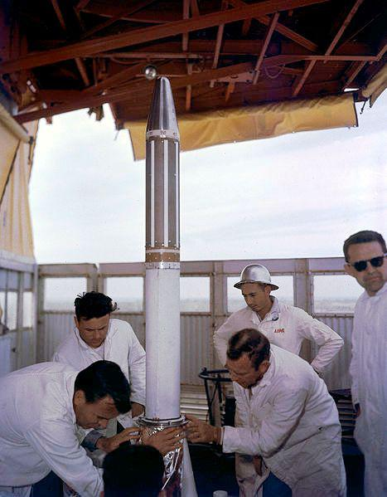
Explorer 1 installed in 1958

Slide 5
Transition of NACA to NASA
On January 12, 1958, NACA organized a "Special Committee on Space Technology", headed by Guyford Stever.
In April 1958, Eisenhower delivered to the U.S. Congress an executive address favoring a national civilian space agency and submitted a bill to create a "National Aeronautical and Space Agency."
On July 29, 1958, Eisenhower signed the National Aeronautics and Space Act, establishing NASA.

